Slide 1
Domain Name System (DNS)
June 2015

Slide 2
Agenda
I. Introduction
II. Important DNS terminology:
III. Tools NSLOOKUP
IV. Tools Use WireShark to capture

Slide 3
Introduction
Using a host name is preferred when communicating over a network. Easily remembered than an IP address
Before 1982, HOSTS.TXT is used to map names to numerical addresses and each computer retrieved this file a computer at SRI
The rapid growth of the network made a centrally maintained, hand-crafted HOSTS.TXT unsustainable
A more scalable system is needed so Domain Name System (DNS) was invented in 1983

Slide 4
Introduction
DNS is a hierarchical distributed naming system for computers, services, or any resource connected to the Internet or a private network
Resolves queries for domain names into IP addresses.
An essential component of the functionality of the Internet.
The DNS protocol defines a set of messages sent over either User Datagram Protocol (UDP) port 53 or Transmission Control Protocol (TCP) port 53.

Slide 5
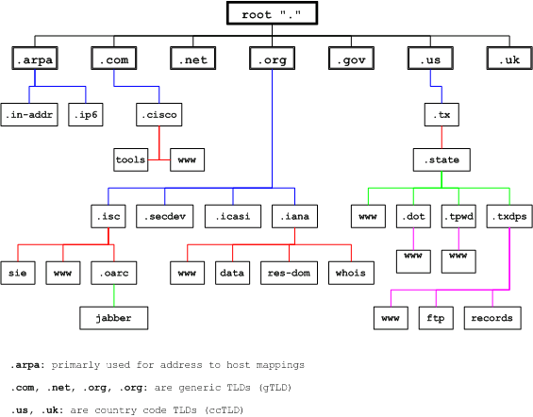
Introduction
The DNS namespace is based on a hierarchical and logical tree structure.

Slide 6
Important DNS terminology
Domain namespace, Domain name, Domain and subdomain
Domain namespace is the structure of the DNS database. A domain namespace that will contain a "tree" of domain names.
Domain name: Each node in the tree has a private label. An empty label representing the root. A full domain name of any node in the "tree" is the order of the labels in the path from that node to the root.
A domain is a branch of the namespace. The domain is the set of nodes that have the same parent node, this node creates a domain.
Domains can be further partitioned at node points within the domain into subdomains for the purposes of administration or load balancing.

Slide 7
Important DNS terminology
Domain com.au
The ausregistry.com.au sub-domain of com.au

Slide 8
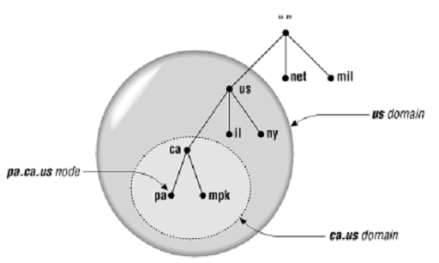
Important DNS terminology
TLD (Top level domain): child of root
The top of the hierarchy is served by the root nameservers, the servers to query when looking up (resolving) a TLD.
Us, vn are ccTLDs (country code TLD)
Mil, net are gTLDs (Generic TLD)

Slide 9
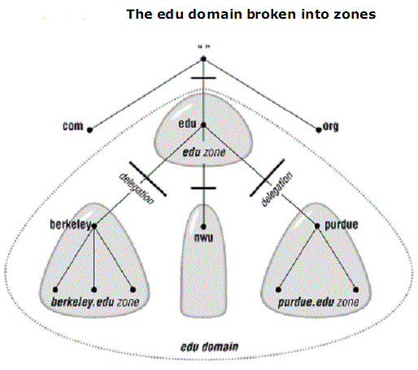
Important DNS terminology
Name Server
Name server: The programs that store information about the domain name space are called name servers
Name servers generally have complete information a zone, which they load from a file or from another name server.
The name server is then said to have authority for that zone
The name server is then said to have authority for that zone

Slide 10
Important DNS terminology
Name Server
DNS defines two types of name servers:
Primary name server: is the primary DNS server, which contains all the information for domain, allowed to add, delete, edit your DNS DATABASE
Secondary name server: is the DNS server, backup, DATABASE of the Primary again. Not change the DNS DATABASE. In case the Primary name server is fail, the Secondary is used for name resolution
There is also a Caching-only servers are DNS servers that only perform queries, cache the answers, and return the results.

Slide 11
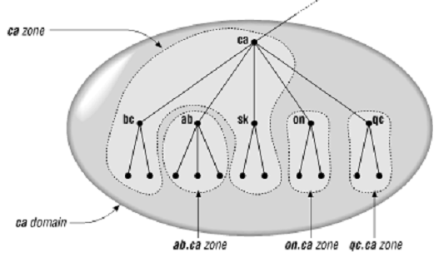
Important DNS terminology
Domain name and zone
Zone and domain can share the domain name (ca) but contain different node
Domain name ca contains all data in ca + all data in ab.ca, on.ca and qc.ca
Zone ca only contains all data in ca

Slide 12
Important DNS terminology
Delegation
An organization administering a domain can divide it into subdomains.
Each of those subdomains can be delegated to other organizations.
This means that an organization becomes responsible for maintaining all the data in that subdomain.
It can freely change the data, and even divide up its subdomain into more subdomains and delegate those. The parent domain retains only pointers to sources of the subdomain's data so that it can refer queriers there.

Slide 13
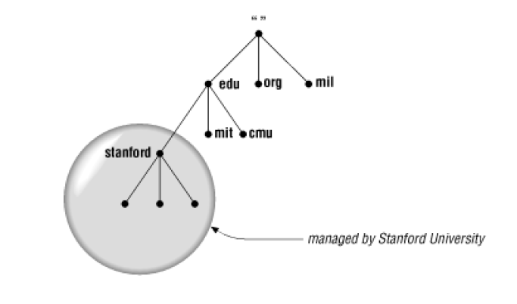
Important DNS terminology
Delegation
The domain stanford.edu, for example, is delegated to the folks at Stanford who run the university's networks

Slide 14
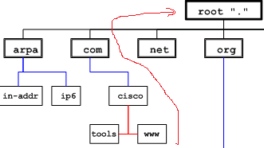
Important DNS terminology
Fully Qualified Domain Name (FQDN)
A fully qualified domain name (FQDN) is a DNS domain name that has been constructed from its location relative to the root of the namespace (known as the root domain).
FQDN: www.cisco.com.”

Slide 15
Important DNS terminology
Types of Queries
Recursive queries:
“.” root NS
2
8
3
Local NS
9
1
www.tma.com.vn
Vn. ns
10
4
www.tma.com.vn A IN 221.133.0.1
7
com.vn. ns
5
6
Tma.com.vn. ns

Slide 16
Important DNS terminology
Types of Queries
“.” root NS
Iterative queries:
4 ask vn
3
6 ask com.vn
1
Vn. ns
www.tma.com.vn
Local NS
2 ask root
5
9 www.tma.com.vn IN A 221.133.0.1
8 ask tma.com.vn
7
8
com.vn. ns
Tma.com.vn. ns

Slide 17
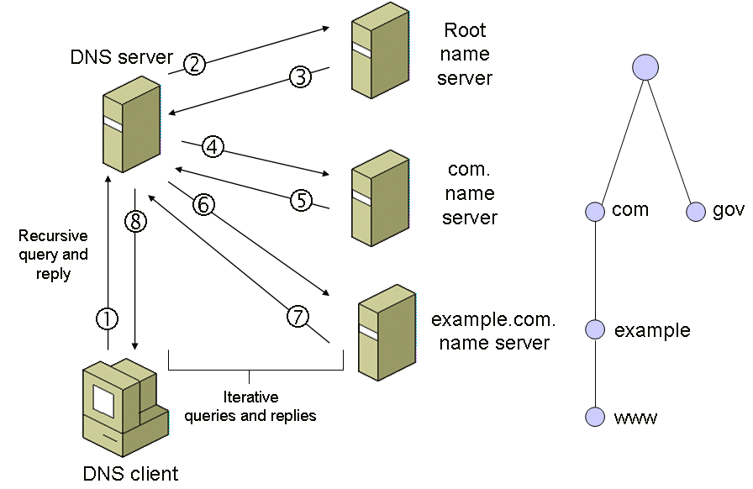
Important DNS terminology
Types of Queries
Real deployment:
- Queries between Resolver --> DNS Server is the recursive query
- Queries between DNS Server --> DNS Server---is interactive query

Slide 18
Important DNS terminology
Caching
DNS Server and Client will save these queries (caching) to be the next time it will search in the cache before If queries have in the cache it will answer immediately without further queries. This helps for faster operations network (performing).

Slide 19
Important DNS terminology
Reverse Queries
Is a query of the DNS for domain names when the IP address is known.
The DNS stores IP addresses in the form of domain names as specially formatted names in pointer (PTR) records within the infrastructure top-level domain arpa.
For IPv4, the domain is in-addr.arpa. For IPv6, the revers19e lookup domain is ip6.arpa.
E.g. the IPv4 address 208.80.152.2 is assigned to Wikimedia then represented in reverse order like 2.152.80.208.in-addr.arpa.

Slide 20
Important DNS terminology
Reverse Queries
Nodes in the in-addr.arpa domain are labeled after the numbers in the dotted-octet representation of IP addresses.
The in-addr.arpa domain, for example, could have up to 256 subdomains, one corresponding to each possible value in the first octet of an IP address.
Each of these subdomains could have up to 256 subdomains of its own, corresponding to the possible values of the second octet.
Finally, at the fourth level down, there are resource records attached to the final octet giving the full domain name of the host at that IP address

Slide 21
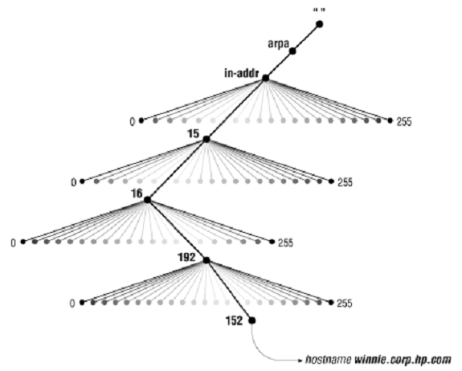
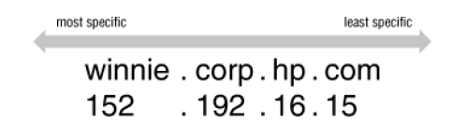
Important DNS terminology
Reverse Queries
A: 15.16.192.152.
152.192.16.15.in-addr.arpa

Slide 22
Important DNS terminology
Resource Record
A domain contains resource records
Resource records are analogous to files
Classified into types
Some of the important types are SOA, NS, A, AAAA*, CNAME and MX
Normally defines in “zone files”

Slide 23
Important DNS terminology
SOA Records
The SOA record indicates that this name server is the best source of information for the data within this zone.
There can be one, and only one, SOA record in a zone data file.
Eg. The record:
domain-name IN SOA mname rname (
serial refresh retry expire minimum time-to-live)
movie.edu. IN SOA terminator.movie.edu. al.robocop.movie.edu.(
1 ; Serial
3h ; Refresh after 3 hours
1h ; Retry after 1 hour
1w ; Expire after 1 week
1h ) ; Negative caching TTL of 1 day

Slide 24
Important DNS terminology
SOA Records
domain-name: domain name of this zone
mname: domain name of the name server that was the original or primary (master) source of data for this zone.
rname: the mailbox of the person responsible for this zone (a "." is used instead of an "@“)
serial: version number of the original copy of the zone. Zone transfers preserve this value
refresh: the time (in seconds) a secondary DNS server waits before querying the primary DNS server's SOA record to check for changes and request a zone transfer
retry: the time (in seconds) a secondary server waits before retrying a failed zone transfer
expire: the time (in seconds) that a secondary server will keep trying to complete a zone transfer, if this time expires prior to a successful zone transfer, the secondary server will expire its zone file (i.e., it will stop answering queries)
minimum time-to-live: The Minimum Time to Live is the number of seconds an external caching

Slide 25
Important DNS terminology
NS Records (Name Server Records)
Indicates the servers that are authoritative for a zone.
NS records indicate primary and secondary servers for the zone specified in the SOA resource record, and they indicate the servers for any delegated zones.
Every zone must contain at least one NS record at the zone root.
Eg. The record:
movie.edu. IN NS terminator.movie.edu.
movie.edu. IN NS wormhole.movie.edu.

Slide 26
Important DNS terminology
A Records (Address Records)
Maps an FQDN to an IPv4 address.
example.com. A 192.0.2.1 ;IPv4 address for example.com ns.example.com. A 192.0.2.2 ;IPv4 address for ns.example.com
AAAA
Maps an FQDN to an IPv6 address
PTR (Pointer)
Maps an IP address to an FQDN for reverse lookups.
1.249.249.192.in-addr.arpa. IN PTR wormhole.movie.edu. 2.249.249.192.in-addr.arpa. IN PTR robocop.movie.edu.

Slide 27
Important DNS terminology
CNAME Records
A CNAME defines an alias
The alias will then be resolved, if another CNAME is encountered then the process continues until an A record is found.
Eg. The record: www.example.com is an alias for example.com
www.example.com. CNAME example.com.
MX Records ( Mail Exchange Records)
An MX record defines the mail servers for a particular domain
Eg. The record:
ausregistry.com.au MX 10 mail
In the ausregistry.com.au domain, defines the host mail to be the priority 10 mail server for the “ausregistry.com.au” domain

Slide 28
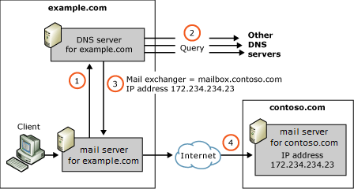
Important DNS terminology
MX Records ( Mail Exchange Records)

Slide 29
NSLOOKUP
What is NSLOOKUP ?
Nslookup is the name of a program that lets an Internet server administrator or any computer user enter a host name and find out the corresponding IP address. It will also do reverse name lookup and find the host name for an IP address you specify.
Some basic commands in NSLOOKUP
Syntax
Lookup ip address of MyHost: NSLOOKUP [-option] MyHost
nslookup www.tmasolutions.com
Lookup ip address of Host on NameServer: NSLOOKUP [-option] Host NameServer
nslookup www.tmasolutions.com google-public-dns-a.google.com
"command mode": NSLOOKUP

Slide 30
NSLOOKUP
Some basic commands in NSLOOKUP
Command Mode options:
help or ? - print a list of Command Mode options
exit or ^C - exit "command mode"
set all - print options, current server and host
MyHost - print ip address of MyHost
MyHost MyNameServer - print ip address of MyHost on MyNameServer
set [no]debug - print debugging info
set [no]d2 - print exhaustive debugging info
set domain=NAME - set default domain name to NAME
set root=NAME - set root server to NAME
root - set current default server to the root
server NAME - set default server to NAME, using current default server
lserver NAME - set default server to NAME, using initial server
set srchlist=N1[/N2/.../N6] - set domain to N1 and search list to N1, N2,...

Slide 31
NSLOOKUP
Some basic commands in NSLOOKUP
set retry=X - set number of retries to X
set timeout=X - set initial time-out interval to X seconds
set [no]defname - append domain name to each query
set [no]recurse - ask for recursive answer to query
set [no]search - use domain search list
set [no]vc - always use a virtual circuit
set class=X - set query class (for example, IN (Internet), ANY)
set [no]msxfr - use MS fast zone transfer
set ixfrver=X - current version to use in IXFR transfer request
set type=X - set query type
set querytype=X - set query type (e.g. A, ANY, CNAME, MX, NS, PTR, SOA, SRV)
ls [opt] DOMAIN [> FILE] - list addresses in DOMAIN (and optionally output to FILE)
+ -d - list all records
+ -t TYPE - list records of the given Type (for example, A, CNAME, MX, NS, PTR, and so on)
+ -a - list Aliases and canonical names.
view FILE - sort an 'ls' output file and view it with pg

Slide 32
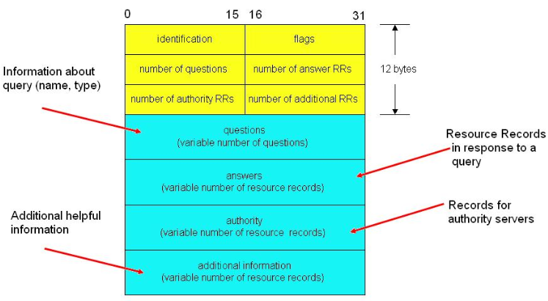
Use WireShark to capture
Message format
Resolver generates ID and is copied in the coresponding reply

Slide 33
Use WireShark to capture
Flags
QR | Opcode | AA | TC | RD | RA | Z | RCODE
- QR (1bit): Query(0)/Response(1)
- OpCode (4bits):
0: a standard query (QUERY)
1: a inverse query (IQUERY)
2: Server status req (STATUS)
3-15: Reserved
- AA (1 bit): Authoritative Answer. Set in response, server is an authority for domain name in question
TC (1bit): Truncation: message was truncated due to length greater than transmission channel
RD (1 bit): Recursion Desired. It is set in Query that directs the name server to pursue the query recursively
RA (1bit): Recursion Available. It is set in Response which denotes whether recursive query support is available in the name server
Z (3bits): Reserved. Must be in Zero
RCODE (4bits): Response code
ID | FLAGS
nb of Question RRs | nb of Answer RRs
nb ofAuthority RRs | nb of Additional RRs
Questions
Answers
Authority
Additional Info

Slide 34
Use WireShark to capture
Question section format
QTYPE:Name – Value - Meaning
A 1 a host address
NS 2 an authoritative name server
MD 3 a mail destination (Obsolete - use MX)
MF 4 a mail forwarder (Obsolete - use MX)
CNAME 5 the canonical name for an alias
SOA 6 marks the start of a zone of authority
MB 7 a mailbox domain
MG 8 a mail group member
MR 9 a mail rename domain name
NULL 10 a null RR
WKS 11 a well known service description
PTR 12 a domain name pointer
HINFO 13 host information
MINFO 14 mailbox or mail list information
MX 15 mail exchange
TXT 16 text strings
1 |  |  |  | 15
QNAME
QTYPE
QCLASS
ID | FLAGS
nb of Question RRs | nb of Answer RRs
nb ofAuthority RRs | nb of Additional RRs
Questions
Answers
Authority
Additional Info

Slide 35
Use WireShark to capture
Question section format
1 |  |  |  | 15
QNAME
QTYPE
QCLASS
QCLASS:
IN 1 the Internet
CS 2 the CSNET class (Obsolete)
CH 3 the CHAOS class
HS 4 Hesiod
ID | FLAGS
nb of Question RRs | nb of Answer RRs
nb ofAuthority RRs | nb of Additional RRs
Questions
Answers
Authority
Additional Info

Slide 36
Use WireShark to capture
Answer, Authoritive and Additional section format
1 |  |  |  | 15
NAME
TYPE
CLASS
TTL
RLENGTH
RDATA
TTL: interval that RR may be cached before it should be discarded. 0 should not be cached
ID | FLAGS
nb of Question RRs | nb of Answer RRs
nb ofAuthority RRs | nb of Additional RRs
Questions
Answers
Authority
Additional Info

Slide 37
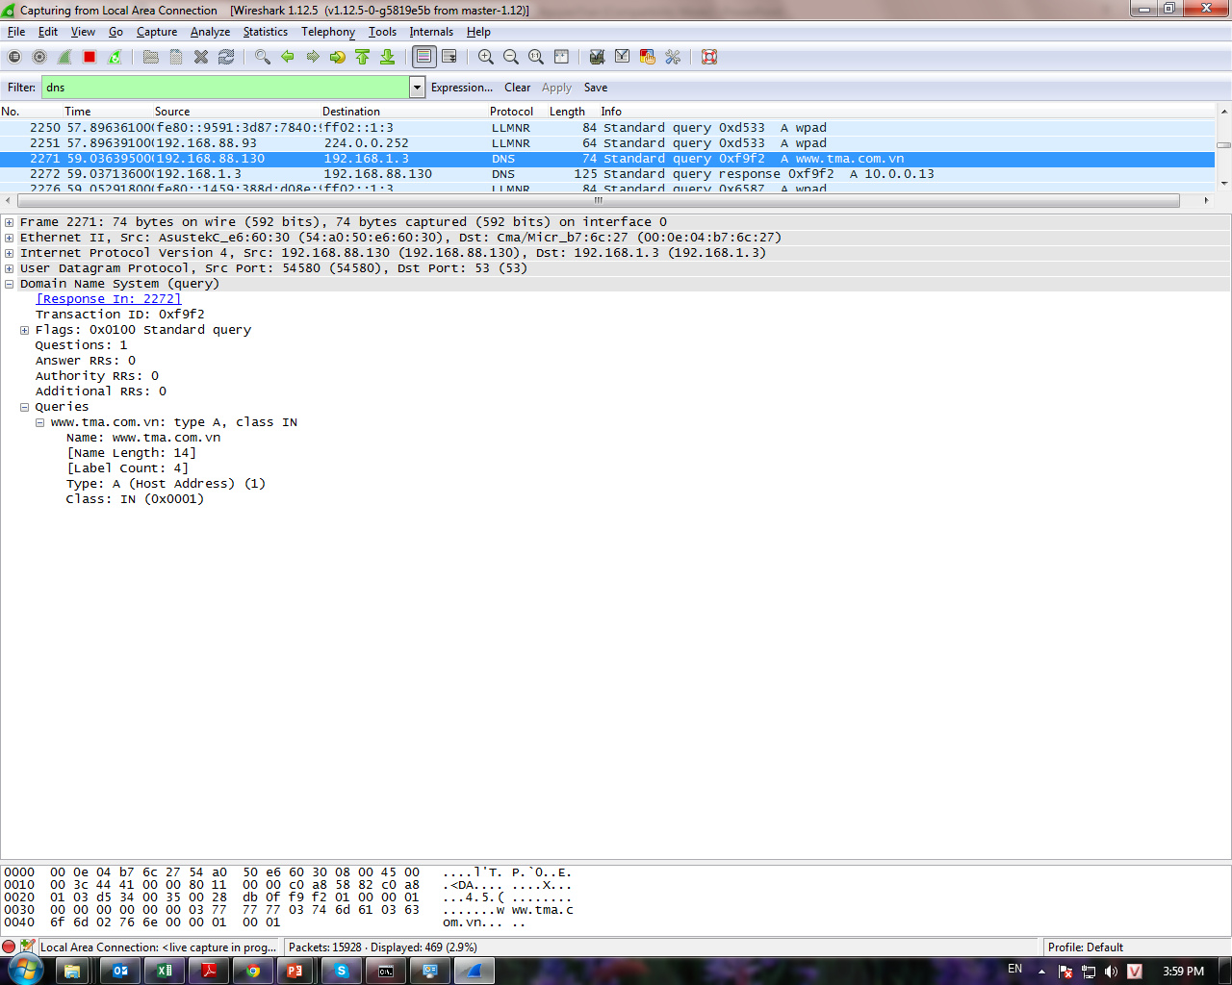

Slide 38
